Slide 1
An algorithm for the elimination of all first order internal multiples from all reflectors in a 1D medium: theory and TESTS including bandwidth and noise
Yanglei Zou

Slide 2
Internal multiple removal

Slide 3
Internal multiple removal
Internal multiple attenuation algorithm
Araújo et al(1994)，Weglein et al. (1997)
Notes:
The ISS first order internal multiples attenuator provides the exact time and approximate amplitude of all first order internal multiples that have a single downward reflection at any reflector.

Slide 4
Algorithm & Adaptive
Case 1
Case 2
data
predicted
multiple
data
predicted
multiple
Solution
Solution
Internal multiple attenuation
+ adaptive subtraction
Internal multiple elimination
Notes:
On shore data, and off shore data

Slide 5
Internal multiple removal
Internal multiple attenuation algorithm
Araújo et al(1994)，Weglein et al. (1997)
Predicting correct amplitude
Spurious events removal
Ma et al(2012),Liang et al(2012)

Slide 6
Internal multiple removal
Internal multiple attenuation algorithm
Araújo et al(1994)，Weglein et al. (1997)
Predicting correct amplitude
Spurious events removal
Ma et al(2012),Liang et al(2012)
Early ideas
Ramírez(2005)

Slide 7
Internal multiple removal
Internal multiple attenuation algorithm
Araújo et al(1994)，Weglein et al. (1997)
Predicting correct amplitude
Spurious events removal
Ma et al(2012),Liang et al(2012)
Early ideas
Ramírez(2005)
Elimination first order internal multiples generated at the shallowest reflector
(1D normal incidence)
Herrera(2012)

Slide 8
Internal multiple removal
Internal multiple attenuation algorithm
Araújo et al(1994)，Weglein et al. (1997)
Predicting correct amplitude
Spurious events removal
Ma et al(2012),Liang et al(2012)
Early ideas
Ramírez(2005)
Elimination first order internal multiples generated at the shallowest reflector
(1D normal incidence)
Herrera(2012)
An algorithm to eliminate all first order internal multiples from all reflectors under 1D normal incidence
(This presentation)
Notes:
This algorithm benefits from the previous work of Welberth Herrera. And it is a generalization of the work.

Slide 9
The structure of this presentation
Internal multiple attenuation algorithm
Araújo et al(1994)，Weglein et al. (1997)
Amplitude issue
Attenuation factor
This new elimination algorithm
Numerical Tests
Conclusion

Slide 10
The structure of this presentation
Internal multiple attenuation algorithm
Araújo et al(1994)，Weglein et al. (1997)
Amplitude issue
Attenuation factor
This new elimination algorithm
Numerical Tests
Conclusion

Slide 11
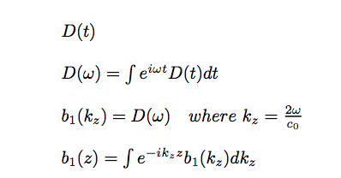
The 1D normal incidence version of the internal multiple attenuation algorithm is presented as follows:

Slide 12
AF₁= T₀₁T₁₀
Notes:
To improve the amplitude, we begin by identifying the difference between the amplitude of the attenuator and the actual internal multiple for the simplest 2 layered case and then we will discuss the the more general case of n reflectors
…
In this case of two reflector, it is relatively easy to see where the fix resides in terms of the data, and that fix for too much T01,T10 come from the b1(z) combination from the inner integral.

Slide 13
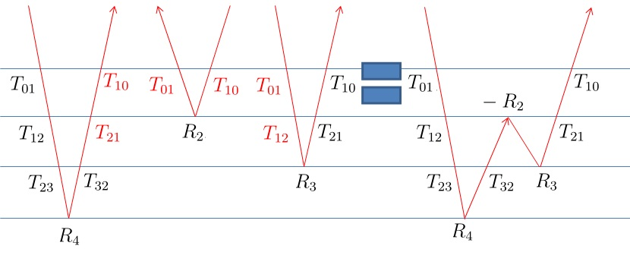
AF₁= T₀₁T₁₀
AF₂= (T₀₁T₁₀)²T₁₂T₂₁
Notes:
Now let us look at a more complex example.
the analysis is much more complicated and the difference is depend on the transmission coefficients down to and including the shallowest downward reflection.
And moving an attenuator into an eliminator needs to correct for a sequence of transmission coefficient at and above the shallowest reflector corresponding to a specific internal multiple.

Slide 14
A generalization of the attenuation factor(AF) for first order internal multiples(1D normal incidence) is given by the following:
(using transmission coefficients)
(using reflection coefficients)

Slide 15
The structure of this presentation
Internal multiple attenuation algorithm
Araújo et al(1994)，Weglein et al. (1997)
Amplitude issue
Attenuation factor
This new elimination algorithm
Numerical Tests
Conclusion

Slide 16
The idea: Modify the term in the second integral to remove the attenuation factor without needing to determine subsurface properties but directly in terms of data.
Notes:
5,Clearer explanation of choosing the middle integral.

Slide 17
The idea: Modify the term in the second integral to remove the attenuation factor without needing to determine subsurface properties but directly in terms of data.
AF₂= (T₀₁T₁₀)²T₁₂T₂₁
Notes:
5,Clearer explanation of choosing the middle integral.
Moving an attenuator into an eliminator needs to correct for a sequence of transmission coefficient at and above the shallowest reflector corresponding to a specific internal multiple.
This procedure is complicated……..

Slide 18
b₁(z)
F[b₁(z)]
AF
T
all R
all R’
b₁(z)
Notes:
T needs to be removed

Slide 19
b₁(z)
F[b₁(z)]
AF
T
all R
all R’
b₁(z)
Very complex

Slide 20
b₁(z)
F[b₁(z)]
AF
T
all R
all R’
b₁(z)
Very complex

Slide 21
b₁(z)
F[b₁(z)]
partial R’
b₁(z)
AF
T
all R
partial R
g(z)
b₁(z)
g(z) is a new function defined with R as coefficients.
Notes:
b1(z)and g(z) both consider only primaries as input.

Slide 22
b₁(z)
F[b₁(z)]
partial R’
b₁(z)
AF
T
all R
partial R
g(z)
b₁(z)
b’₁(z)=b₁(z)+b₃^{IM}(z)
g(z) is a new function defined with R as coefficients.
Notes:
b1(z)and g(z) both consider only primaries as input.

Slide 23
b’₁(z)
F[b₁(z)]
partial R’
b’₁(z)
AF
T
all R
partial R
g(z)
b’₁(z)
b’₁(z)=b₁(z)+b₃^{IM}(z)
g(z) is a new function defined with R as coefficients.
Notes:
b1(z)and g(z) both consider only primaries as input.

Slide 24
b₁(z)
F[b₁(z)]
partial R’
b₁(z)
AF
T
all R
partial R
g(z)
b₁(z)
F[b₁(z)]
b₁(z)
g(z) is a new function defined with R as coefficients.

Slide 25
b₁(z)
F[b₁(z)]
partial R’
b₁(z)
AF
T
all R
partial R
g(z)
b₁(z)
F[b₁(z)]
b₁(z)

Slide 26
The structure of this presentation
Internal multiple attenuation algorithm
Araújo et al(1994)，Weglein et al. (1997)
Amplitude issue
Attenuation factor
This new elimination algorithm
Numerical Tests
Conclusion

Slide 27
In this section we test 3 different equations under 1D normal incidence:
(1) Internal multiple attenuation algorithm
(2) First approximation of the elimination algorithm
(3) Second approximation of the elimination algorithm
(1)
(2)
(3)

Slide 28
Model
V=1500m/s ρ=1.0g/cm³
500m
V=1700m/s ρ=1.8g/cm³
1700m
V=1700m/s ρ=1.0g/cm³
2700m
V=3500m/s ρ=4.0g/cm³
5700m
V=5000m/s ρ=4.0g/cm³

Slide 29
Initial Tests
Test for perfect data.
Test for band limited data.
Test for data with white noise.

Slide 30
Initial Tests
Test for perfect data.
Test for band limited data.
Test for data with white noise.

Slide 31
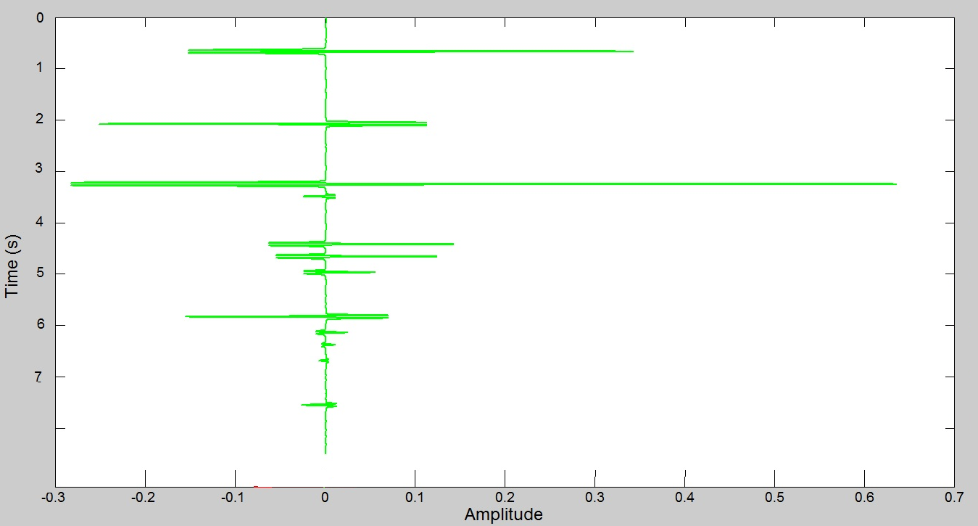
The input data(1D normal incidence)

Slide 32
The input data(1D normal incidence)

Slide 33
Internal multiple attenuation algorithm
P₃
IM₂₁₂
IM₃₂₃
IM₂₁₃ and IM₃₁₂
1
2
3
P₃
IM₂₁₂
IM₂₁₃
IM₃₁₂
IM₃₂₃

Slide 34
First approximation of the elimination algorithm
P₃
IM₂₁₂
IM₃₂₃
IM₂₁₃ and IM₃₁₂
1
2
3
P₃
IM₂₁₂
IM₂₁₃
IM₃₁₂
IM₃₂₃

Slide 35
Second approximation of the elimination algorithm
P₃
IM₂₁₂
IM₃₂₃
IM₂₁₃ and IM₃₁₂
1
2
3
P₃
IM₂₁₂
IM₂₁₃
IM₃₁₂
IM₃₂₃

Slide 36
Initial Tests
Test for perfect data.
Test for band limited data. (10-45Hz)
Test for data with white noise.

Slide 37
Internal multiple attenuation algorithm
P₃
IM₂₁₂
IM₃₂₃
IM₂₁₃ and IM₃₁₂
1
2
3
P₃
IM₂₁₂
IM₂₁₃
IM₃₁₂
IM₃₂₃

Slide 38
First approximation of the elimination algorithm
P₃
IM₂₁₂
IM₃₂₃
IM₂₁₃ and IM₃₁₂
1
2
3
P₃
IM₂₁₂
IM₂₁₃
IM₃₁₂
IM₃₂₃

Slide 39
Second approximation of the elimination algorithm
P₃
IM₂₁₂
IM₃₂₃
IM₂₁₃ and IM₃₁₂
1
2
3
P₃
IM₂₁₂
IM₂₁₃
IM₃₁₂
IM₃₂₃

Slide 40
Initial Tests
Test for perfect data.
Test for band limited data.
Test for data with white noise.
The energy of noise is 2% of the energy of data.

Slide 41
Internal multiple attenuation algorithm
P₃
IM₂₁₂
IM₃₂₃
IM₂₁₃ and IM₃₁₂
1
2
3
P₃
IM₂₁₂
IM₂₁₃
IM₃₁₂
IM₃₂₃

Slide 42
First approximation of the elimination algorithm
P₃
IM₂₁₂
IM₃₂₃
IM₂₁₃ and IM₃₁₂
1
2
3
P₃
IM₂₁₂
IM₂₁₃
IM₃₁₂
IM₃₂₃

Slide 43
Second approximation of the elimination algorithm
P₃
IM₂₁₂
IM₃₂₃
IM₂₁₃ and IM₃₁₂
1
2
3
P₃
IM₂₁₂
IM₂₁₃
IM₃₁₂
IM₃₂₃

Slide 44
Conclusion
In this presentation, a new algorithm is given to eliminate all first order internal multiples under 1D normal incidence directly in terms of data without determining the earth. And this algorithm remains useful with bandwidth and noise.
This algorithm is a part of a project in M-OSRP which is aimed at predicting correct amplitude and time of all internal multiples. This algorithm is a step within seeking this purpose.
There are many cases require new capability for internal multiples removal when primaries and internal multiples interfere with each other in both on-shore and off-shore data. In these cases, the internal multiple elimination project will be particularly relevant and provide value.

